Slide 1
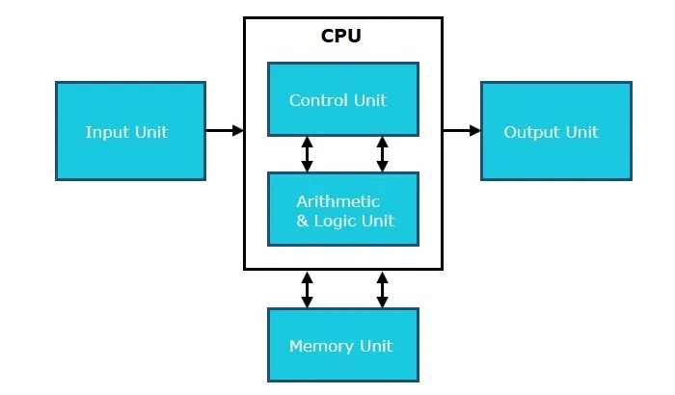
COMPONENTS OF A COMPUTER

Slide 2
Input Unit
The Input Unit is responsible for taking input from the user and external sources through various input devices (like keyboards, mice, or sensors). It converts this input into a binary format that the computer's internal systems can process.

Slide 3
Central Processing Unit (CPU)
The CPU is the core component of a computer system where most of the processing occurs. It includes the Control Unit, which manages the operations of the CPU and its interaction with other components, and the Arithmetic & Logic Unit (ALU), which handles all the arithmetic and logical operations.

Slide 4
Control Unit
The Control Unit manages the operations of the CPU by providing timing and control signals. It is responsible for fetching, decoding, and executing instructions from the memory. It coordinates all the units of the computer.

Slide 5
Arithmetic & Logic Unit (ALU)
The ALU performs basic arithmetic operations (addition, subtraction, multiplication, division) and logical operations (AND, OR, XOR, NOT). It is a critical component for the processing power of the computer.

Slide 6
Memory Unit
The Memory Unit stores data and instructions needed by the CPU. It serves as the internal storage area in the computer, facilitating data retrieval and storage during processing tasks.

Slide 7
Output Unit
After processing the data, the Output Unit converts the results into a form understandable by humans or other machines. Common output devices include monitors, printers, and speakers.

